Slide 1
Integrating Technology in the Classroom

Slide 2
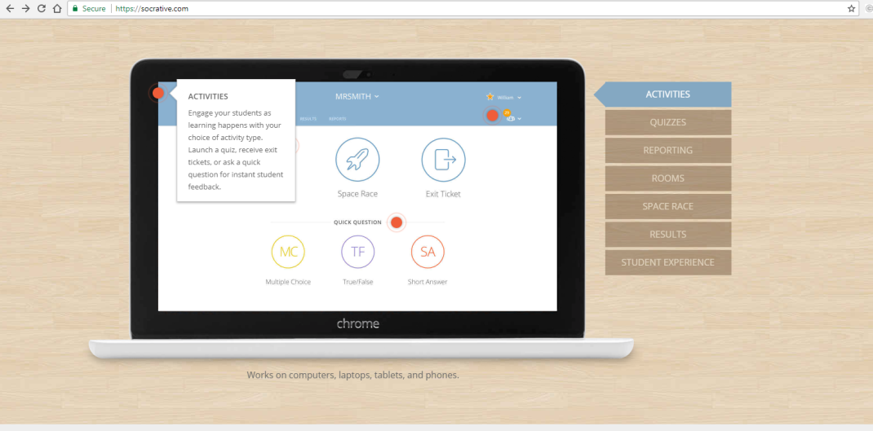
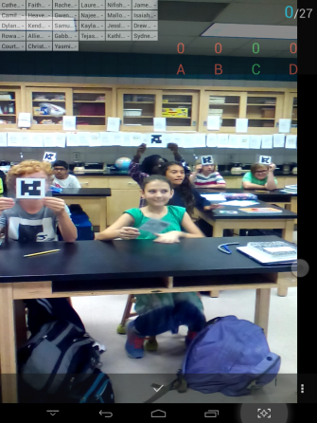
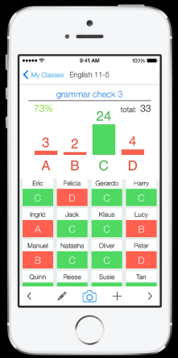
Free Learning Platforms
https://socrative.com
Socrative is your classroom app for fun, effective classroom engagement. No matter where or how you teach, Socrative allows you to instantly connect with students as learning happens.
Quickly assess students with prepared activities or on-the-fly questions to get immediate insight into student understanding. Then use auto-populated results to determine the best instructional approach to most effectively drive learning.
www.plickers.com
Tailor instruction with instant feedback
Give all students the chance to participate and engage in learning without feeling self-conscious.
Use Plickers for quick checks for understanding to know whether your students are understanding big concepts and mastering key skills.

Slide 3
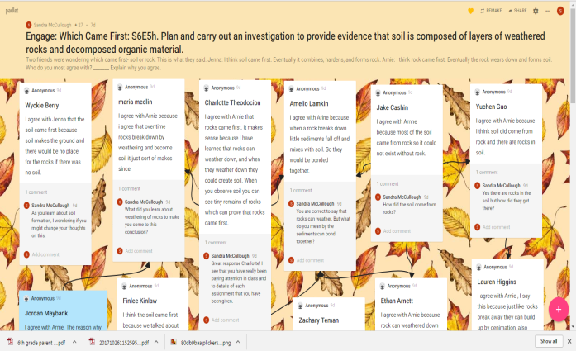
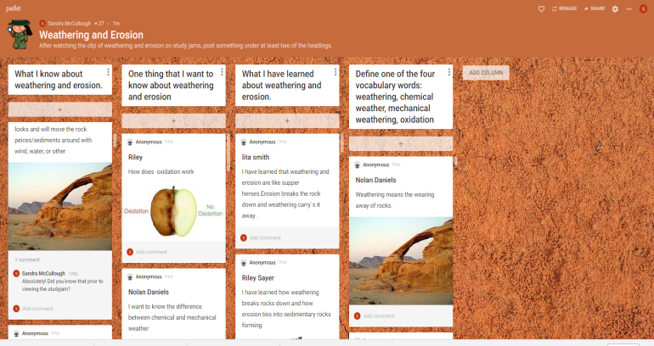
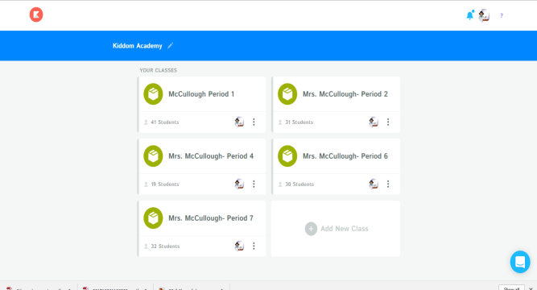
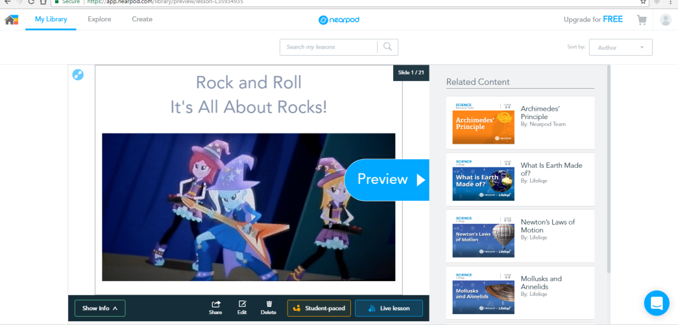
Welcome to the easiest way to create and collaborate in the world.
Can be used as a ticket-out-the-door or class activity.
Kiddom's Planner allows you to design curriculum for a class and seamlessly modify pathways for groups and individuals. To get started, create a unit and drag and drop into your Timeline. It's that simple.
Easily create lessons in minutes for your next class. Import files (pdf, ppt, jpg) or Google slides and add interactive activities, websites, and videos to keep your students engaged in their learning.

Slide 4
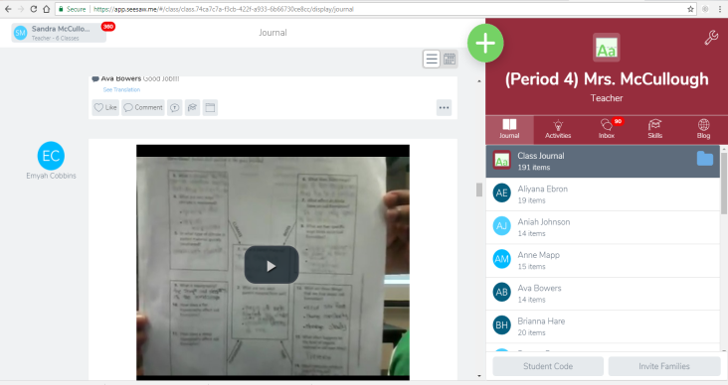
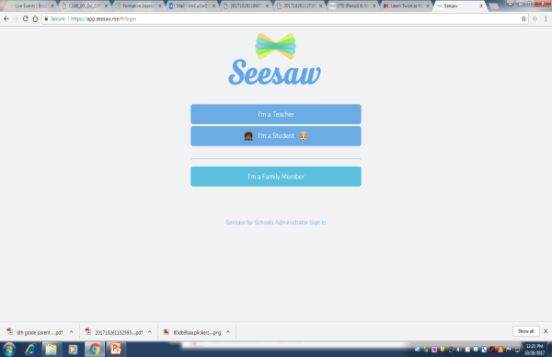
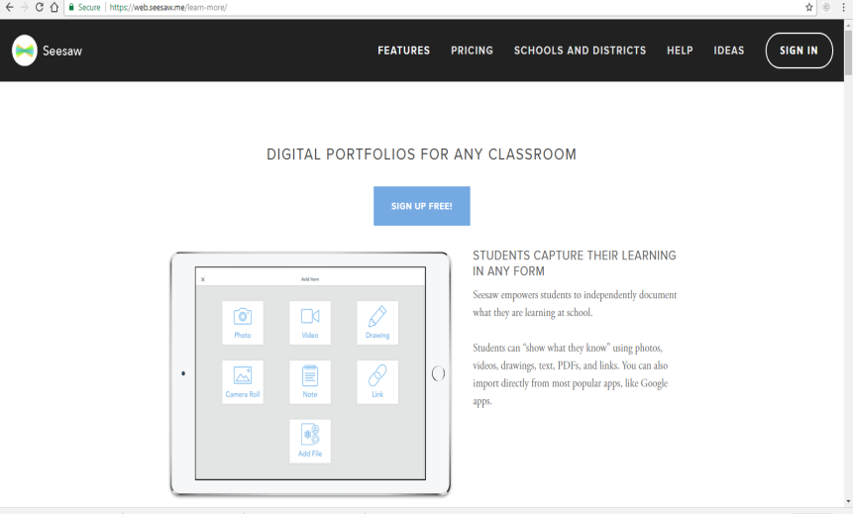
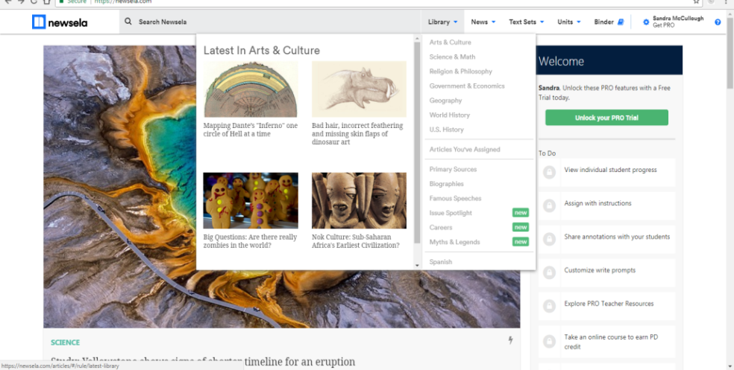
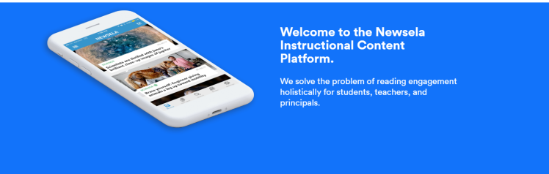
STUDENTS CAPTURE THEIR LEARNING IN ANY FORM
Seesaw empowers students to independently document what they are learning at school.
Students can “show what they know” using photos, videos, drawings, text, PDFs, and links. You can also import directly from most popular apps, like Google apps.
Every great love affair with reading begins with engagement, and Assessments are the ultimate in engagement. Know if students did the reading, if they’ve understood it, and much more. (All from the comfort of your mobile device.)

Slide 5
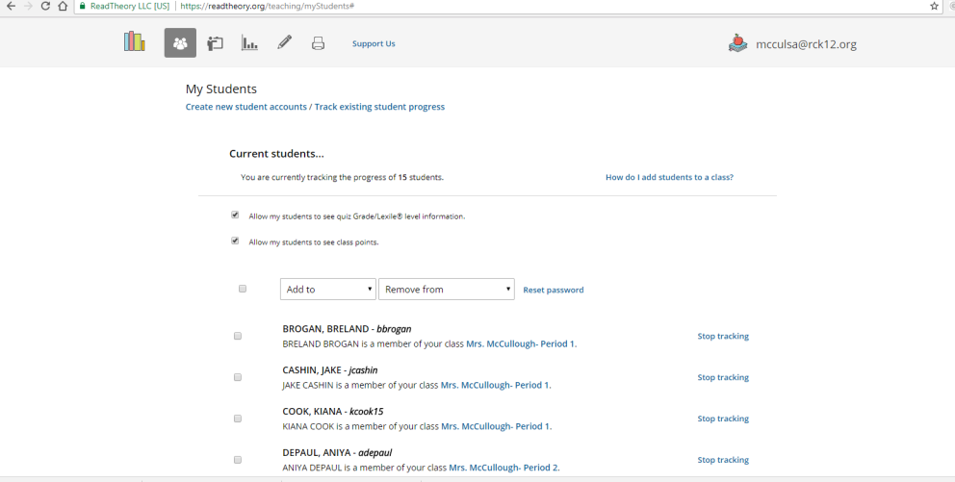
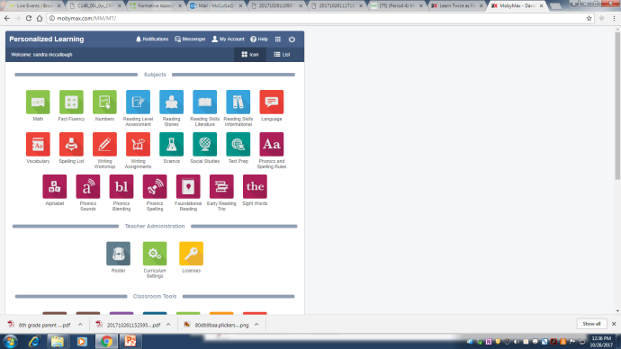
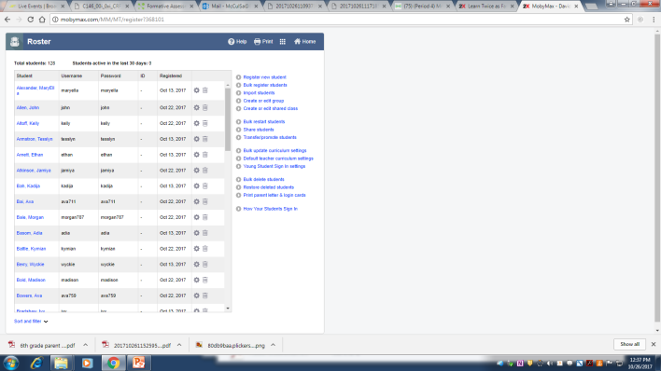
www.readtheory.org
Log in to access free reading comprehension and writing exercises sure to improve your critical thinking skills.
MobyMax enables students to learn twice as fast with award-winning Personalized Learning, Pinpoint Assessments, and Interactive Classroom.

Slide 6
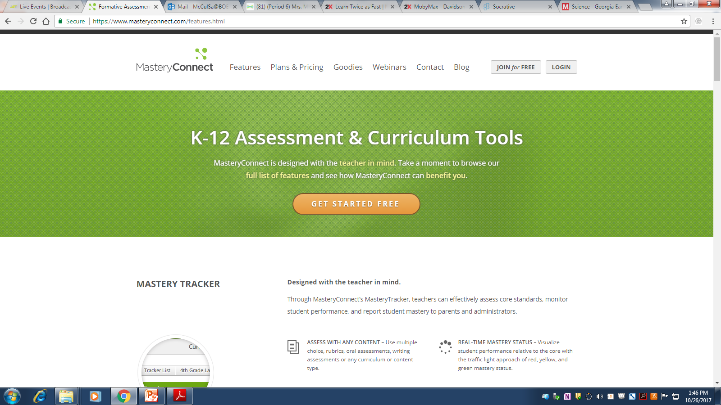
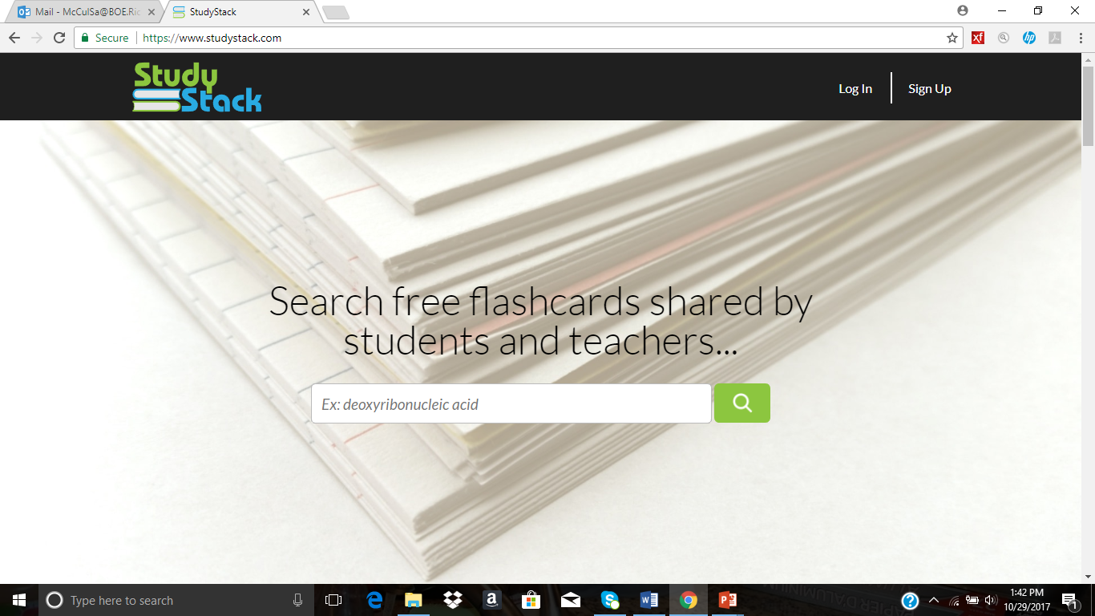
www.masteryconnect.com
Designed with the teacher in mind.
Through MasteryConnect’s MasteryTracker, teachers can effectively assess core standards, monitor student performance, and report student mastery to parents and administrators.
Disclaimer:
I have not yet tried this one.
www.studystack.com
Great way for to practice vocabulary.
Games can be played from the cards created.
User-friendly for both students and teacher.

Slide 7
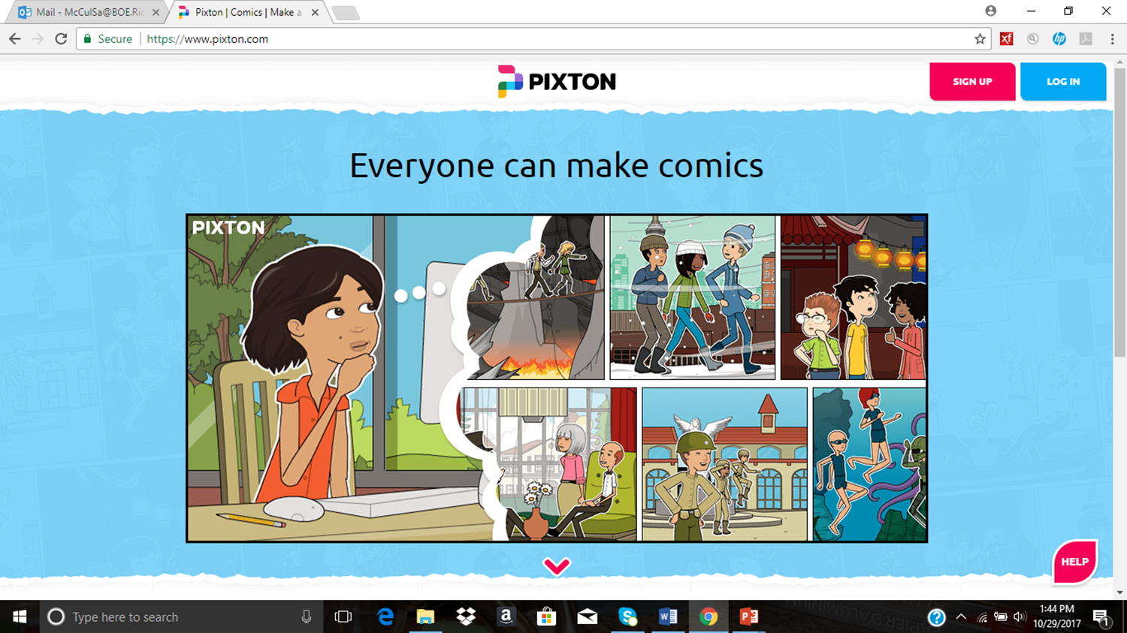
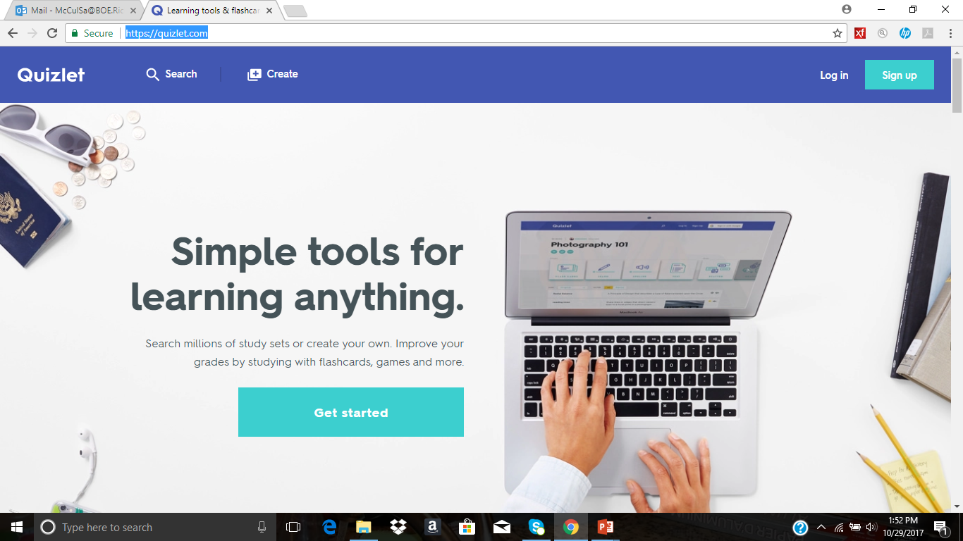
https://www.pixton.com
Not a free site but can be used on a 14 days trial.
Students are able to create and print comic strips.
Great for any class.
https://quizlet.com/
Search millions of study sets or create your own. Improve your grades by studying with flashcards, games and more.

Slide 8
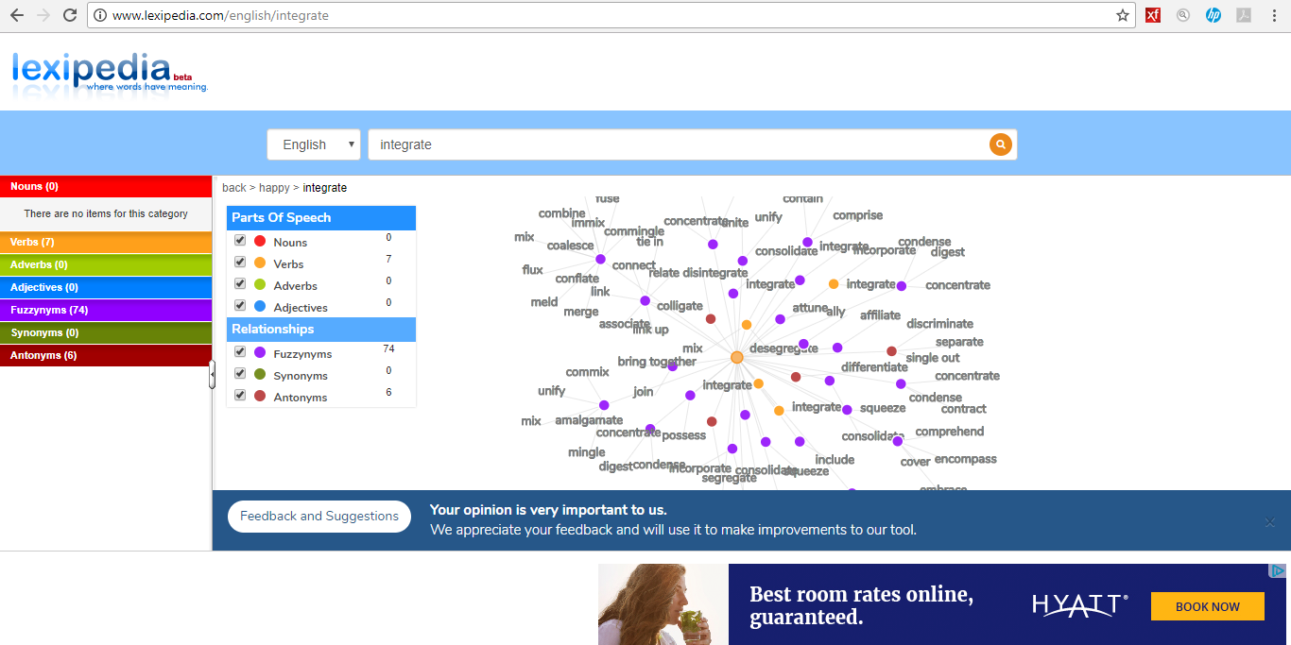
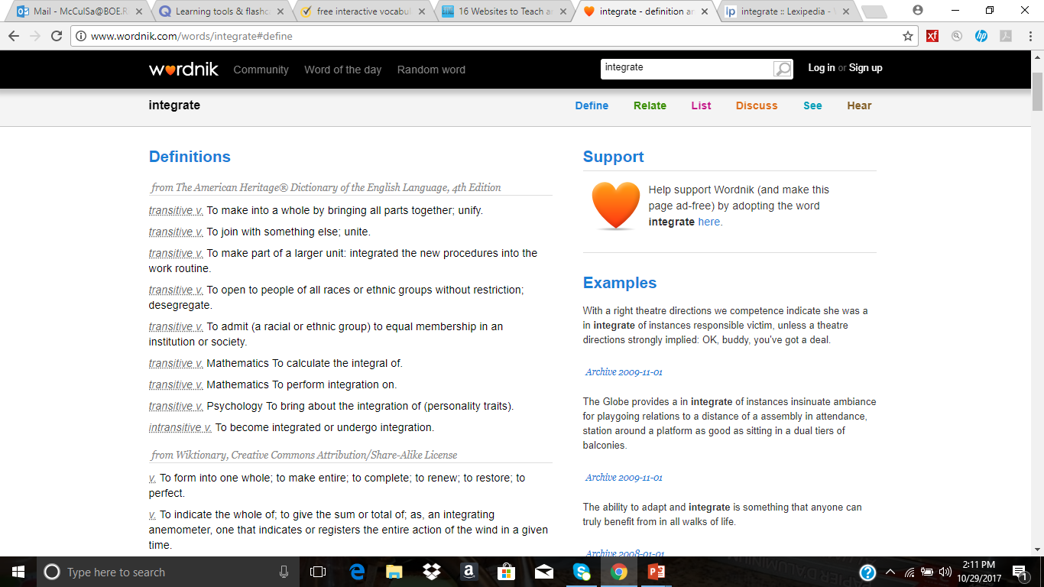
http://www.lexipedia.com
Lexipedia is an online visual semantic network with dictionary and thesaurus reference functionality.
The word searched appears in the middle.
http://www.wordnik.com
Wordnik shows definitions from multiple sources, so you can see as many different takes on a word's meaning as possible.

Slide 9
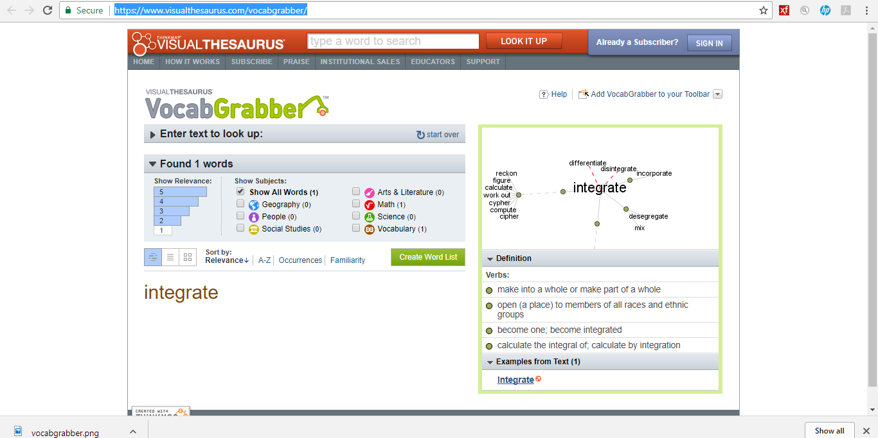
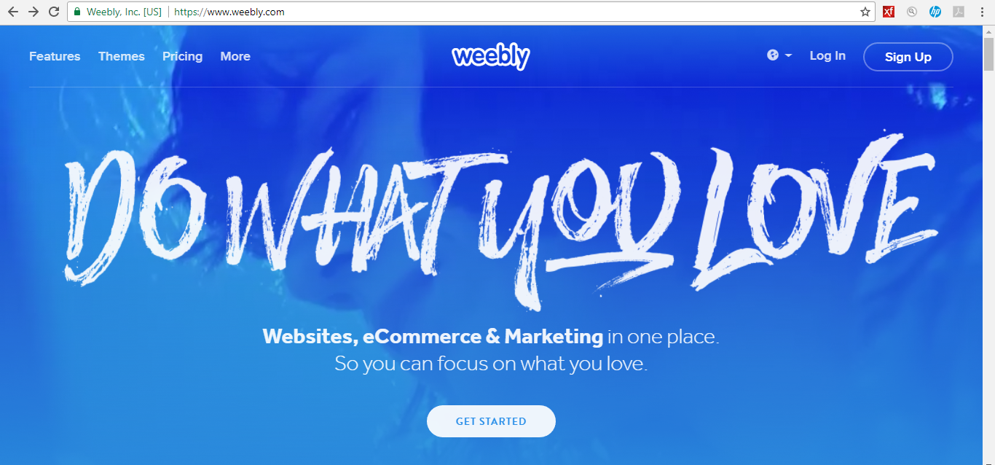
https://www.visualthesaurus.com/vocabgrabber/
VocabGrabber analyzes any text you're interested in, generating lists of the most useful vocabulary words and showing you how those words are used in context.
https://www.weebly.com/
Tell your story with a beautiful website, online store or blog. With Weebly’s drag and drop website builder, integrated eCommerce platform and responsive themes you can build a professional website without any technical experience.

Slide 10
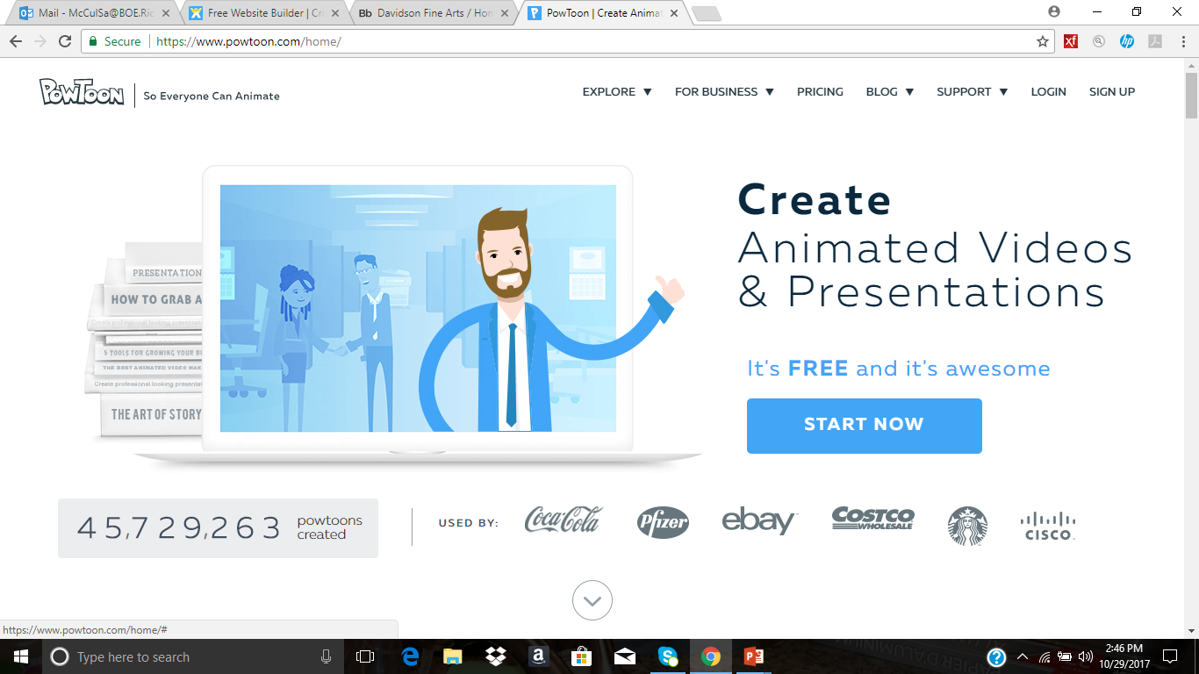
https://www.wix.com/
Creating your stunning website for free is easier than
ever with our website builder. No tech skills needed. Just pick a template, change anything you want, add your images, videos, text and more to get online instantly.
http://jadie618.wixsite.com/allaboutscience
Student sample by Jadieana Robinson
https://www.powtoon.com
Fight distractions in class and grab your students attention by making your education materials come to life with a Powtoon! It’s great for school projects too!

Slide 11
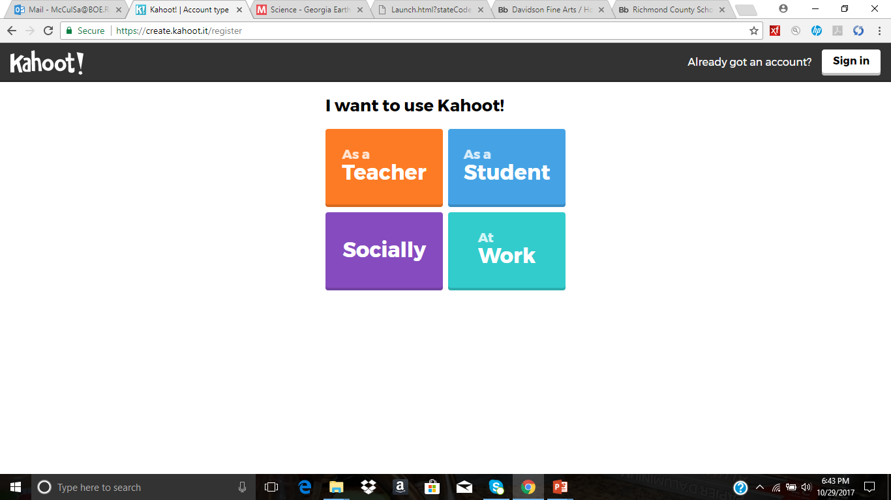
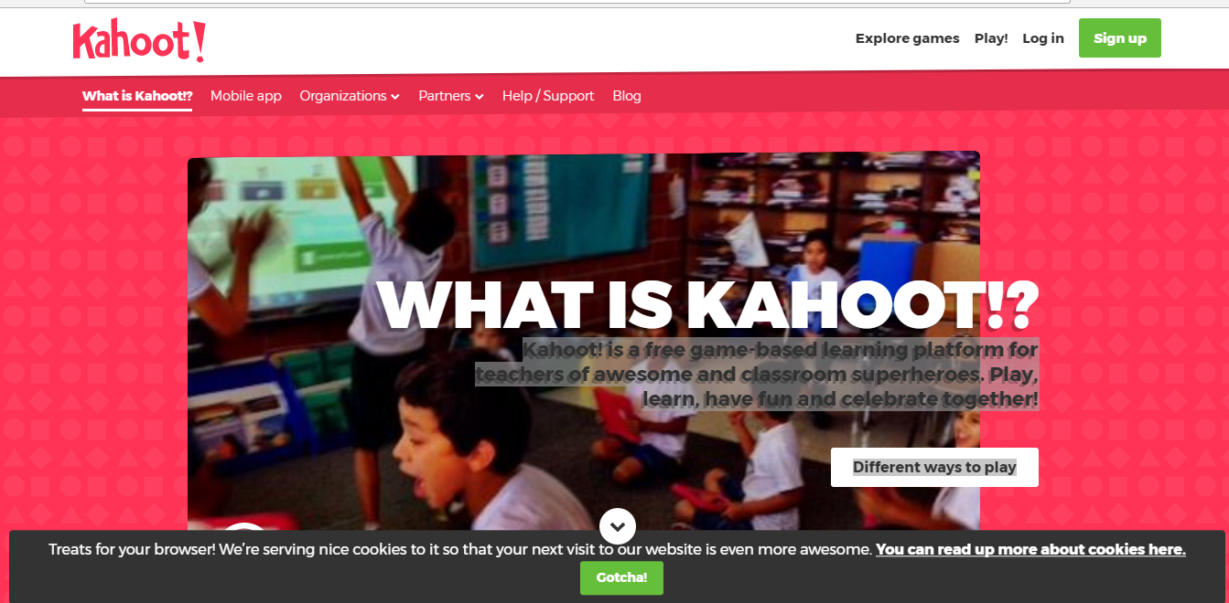
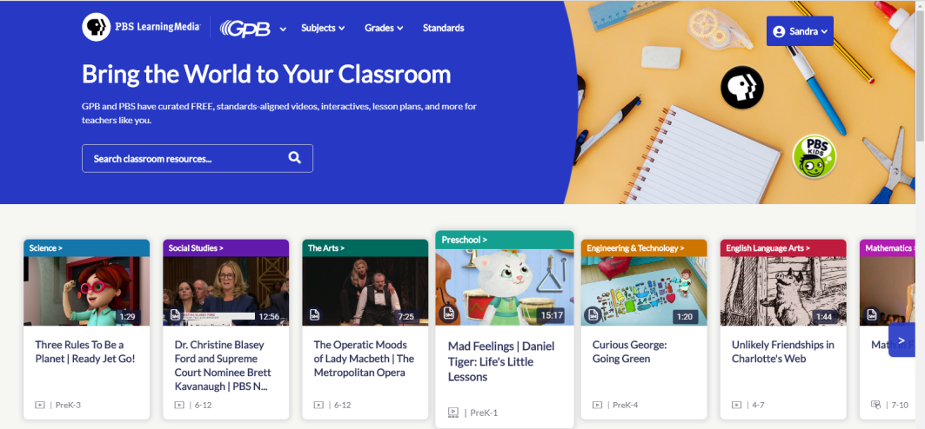
https://kahoot.com
Kahoot! is a free game-based learning platform for teachers of awesome and classroom superheroes. Play, learn, have fun and celebrate together!
https://gpb.pbslearningmedia.org/
GPB and PBS have curated FREE, standards-aligned videos, interactives, lesson plans, and more for teachers like you.

Slide 12
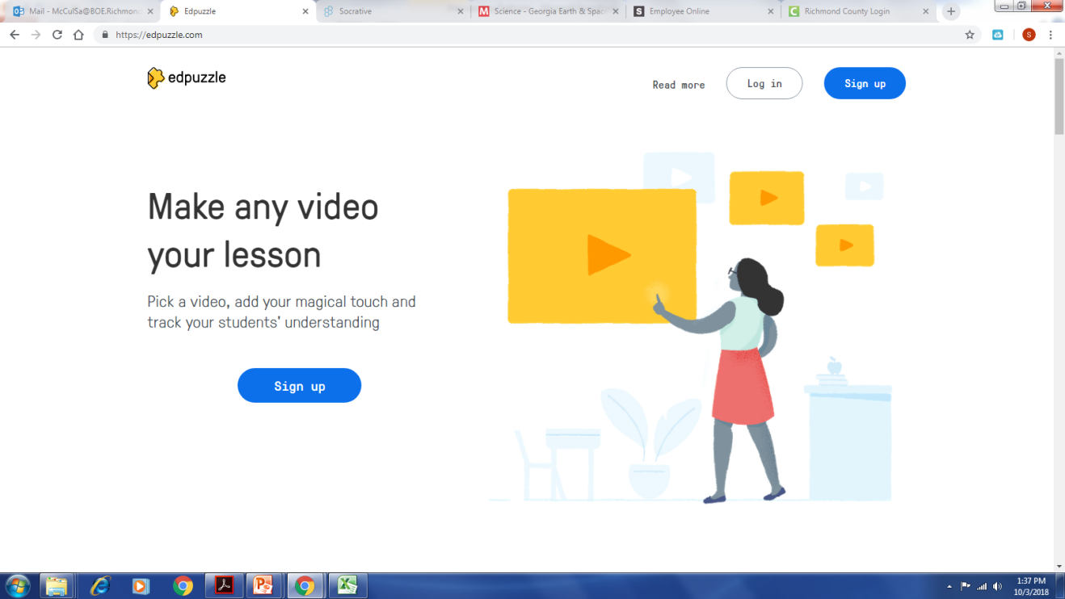
Engage students easily
Enable self-paced learning with interactive lessons, just add your voice and questions within the video.
Reinforce accountability
Know if your students are watching your videos, how many times per section and if they're understanding the content.
Save time
Take already existing videos from YouTube, Khan Academy, Crash Course… or upload your own.

